Slide 1
Cognitive Apprenticeship
——Allan Collins and Manu Kapur
Lecture：Li Jihong

Slide 2
Content
What is cognitive apprenticeship
Difference between schooling and apprenticeship
Framework of cognitive apprenticeship
Themes in research on cognitive apprenticeship

Slide 3
What is cognitive apprenticeship
Apprenticeship was the most common means of learning, used to transmit the knowledge required for expert practice in fields from painting and sculpting to medicine and law.
Cognitive apprenticeship is the retooling of apprenticeship methods for the teaching and learning of cognitive skills. They proposed the development of a new cognitive apprenticeship to teach students the thinking and problem-solving skills involved in school subjects.

Slide 4
What is cognitive apprenticeship
the term apprenticeship emphasizes that cognitive apprenticeship was aimed primarily at teaching the processes that experts use to handle complex tasks.
the term cognitive emphasizes that the focus is on cognitive skills, rather than physical ones.

Slide 5
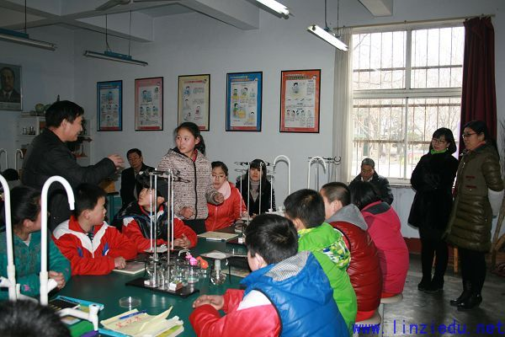
Difference between schooling and apprenticeship
In schools, skills and knowledge taught in schools have become abstracted from their uses in the world.
apprenticeship embeds the learning of skills and knowledge in the social and functional context of their use.

Slide 6
Difference between traditional and cognitive apprenticeship
First, because traditional apprenticeship is set in the workplace, the problems and tasks given to learners arise not from pedagogical concerns, but from the demands of the workplace.
Second, whereas traditional apprenticeship emphasizes teaching skills in the context of their use, cognitive apprenticeship emphasizes generalizing knowledge so that it can be used in many different settings.

Slide 7
Framework of cognitive apprenticeship
Content
Domain knowledge
Strategy knowledge
Methods
Modeling
Coaching
Sequence
Situated learning
Sociology
Increasing complexity
Scaffolding
Articulation
Reflection
Increasing diversity
Exploration
Global to local skills
Community of practice
Intrinsic motivation
cooperation

Slide 8
Framework of cognitive apprenticeship
Content
Domain knowledge: the explicit concepts, facts, and procedures associated with a specialized area
Strategic knowledge: how use their domain knowledge to solve real-world problems
Heuristic strategies — generally applicable techniques for accomplishing tasks
Control strategies — general approaches for directing one’s solution process
Learning strategies — knowledge about how to learn new concepts, facts, and procedures

Slide 9
Framework of cognitive apprenticeship
Method
Modeling — teacher performs a task so students can observe
Coaching — teacher observes and facilitates while students perform a task
Scaffolding — teacher provides supports to help students perform a task
Articulation — teacher encourages students to verbalize their knowledge and thinking
Reflection — teacher enables students to compare their performance with others
Exploration — teacher invites students to pose and solve their own problems

Slide 10
Framework of cognitive apprenticeship
Sequence
Increasing complexity — meaningful tasks gradually increasing in difficulty
Increasing diversity — practice in a variety of situations to emphasize broad application
Global to local skills — focus on conceptualizing the whole task before executing the parts

Slide 11
Framework of cognitive apprenticeship
Sociology
Situated learning — students learn in the context of working on realistic tasks
Community of practice — communication about different ways to accomplish meaningful tasks
Intrinsic motivation — students set personal goals to seek skills and solutions
Cooperation — students work together to accomplish their goals

Slide 12
Themes in research on cognitive apprenticeship
Situated learning
enables students to tackle complex, difficult tasks that are beyond their ability to engage with independently
Articulation
to articulate one’s thinking and knowledge in terms that are not specific to a particular context
Reflection
encourages learners to look back on their performance in a situation and compare their performance to other performances
scaffolding
Communities of practice
Communities of leaner
Learners are given real-world tasks and the scaffolding they need to carry out such tasks in authentic situation.
the notion of legitimate peripheral participation to describe the way that apprentices participate in a community of practice.
to advance the collective knowledge of the community, with the belief that this will ultimately support the growth of individual knowledge

